Slide 1

Force control in hydraulic cylinders
with variable impedance
PhD Student:
Job Ledezma
Supervisors:
Claudio Semini
Victor Barasuol
Genova, Italy – November 2015

Slide 2
1
Introduction
2
Pure Hydroelastic Actuator
3
Hydraulic Actuator with Variable Impedance
Structure of
this presentation
Control technique
4
5
Chronogram

Slide 3

Introduction
Introduction
1

Slide 4
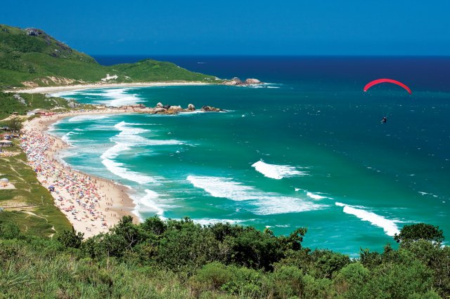
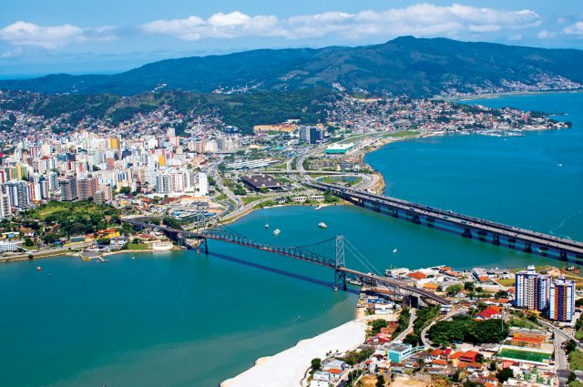

Introduction
Pure Hydroelastic Actuator
Hydraulic Actuator with Variable Impedance
Control Technique
Chronogram
Florianópolis is the capital city and second largest city of the state of Santa Catarina, in the South of Brazil. It is composed of one main island, a continental part and the surrounding small islands.
The city is known for having a very high quality of life, ranked as the country's third highest Human Development Index score among all Brazilian cities.

Slide 5



Introduction
Pure Hydroelastic Actuator
Hydraulic Actuator with Variable Impedance
Control Technique
Chronogram
The Federal University of Santa Catarina (UFSC) is a public university in Florianópolis, the capital city of Santa Catarina. It is one of the leading Brazilian and Latin American research universities, mainly noted for its engineering school.
It campus is divided in 11 Educational Centers, which are divided in departments. The largest one is the Department of Mechanical Engineering. The oldest is the Center of Juridic Sciences, that is itself the department of Law, which was the first of UFSC's departments to be officially recognized in 1932.

Slide 6

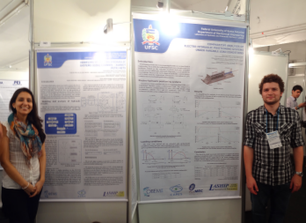
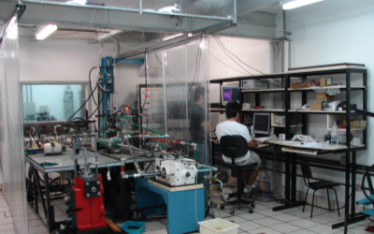
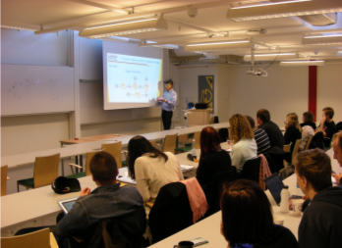
Introduction
Pure Hydroelastic Actuator
Hydraulic Actuator with Variable Impedance
Control Technique
Chronogram
LASHIP – Laboratory of Hydraulic and Pneumatic Systems of the Department of Mechanical Engineering at the Federal University of Santa Catarina has a structure focused on attending university activities of education, research and services.
The LASHIP’s team is involved with undergraduate education since 1977 and graduate education and research on hydraulic and pneumatic components and systems since 1984.

Slide 7
Introduction
Pure Hydroelastic Actuator
Hydraulic Actuator with Variable Impedance
Control Technique
Chronogram
The research funds are from government projects and partnerships with industries. Besides the infrastructure in equipment and facilities, it is established a group made by 3 professors and about 15 people among research engineers and graduate and undergraduate students connected through institutional projects and industry.
Research areas:
1 – Analysis and Design of Hydraulic and Pneumatic Systems and Components;
2 – Integration of Hydraulics and Pneumatics with software and electronics: Mechatronic Solutions;
3 – Computational systems to support the design of hydraulic systems and components

Slide 8
Introduction
Pure Hydroelastic Actuator
Hydraulic Actuator with Variable Impedance
Control Technique
Chronogram
Position and force control are the most common types of hydraulic systems control. However, besides the similarities between them, force control is analytically more complex than position control because the dynamics of the environment has to be included in the control system design.
Force
Control
Position
Control
>>

Slide 9
Introduction
Pure Hydroelastic Actuator
Hydraulic Actuator with Variable Impedance
Control Technique
Chronogram
Hydraulic actuation systems are very stiff due to low compressibility of the fluid and, consequently, very small movements of the cylinder can generate large force variations when the hydraulic actuator is in direct contact with the environment.
Incrementing the system compliance through the reduction of the transmission stiffness would overcome this intrinsic problem of force control.

Slide 10
Introduction
Pure Hydroelastic Actuator
Hydraulic Actuator with Variable Impedance
Control Technique
Chronogram
The compliance in actuators can be obtained by two ways:
Usually expensive due to the high precision process hardware required for this work.
Doesn’t store energy.
Fast change of apparent stiffness.
Active
software
Force feedback-based
Usually cheaper.
Store energy.
It’s possible to vary the stiffness but requires a more sophisticated hardware (not fast)
Passive
hardware
Mechanical components
insertion

Slide 11
Introduction
Pure Hydroelastic Actuator
Hydraulic Actuator with Variable Impedance
Control Technique
Chronogram
The use of springs decrease the complexity of the mathematical model.
Incrementing passively the compliance of the system
Increments the stability during the force control
A spring is a passive element that stores energy and limits the force rate applied over the load or environment. Consequently, it produces a filter effect that increases the system compliance and contributes to obtaining good performances.
Plummer (2007)
Sivaselvan et al. (2008)
Lamming et al. (2010)

Slide 12
Introduction
Pure Hydroelastic Actuator
Hydraulic Actuator with Variable Impedance
Control Technique
Chronogram
The most referenced actuator in the literature using a passive compliance method for controlling the force is the Series Elastic Actuator (SEA) proposed by Williamson (1995). Robinson (2000) extend this study to hydraulic systems and proposed the Hydro-elastic Actuator.
The Hydro-elastic Actuator uses a linear hydraulic actuator followed by a spring where the applied force is indirectly calculated from the measure of the spring deflection.
Hydro-SEA has good force stability, low output impedance, and tolerance to shock loading. However, it shows bandwidth reduction when large forces are applied at power saturations limits

Slide 13
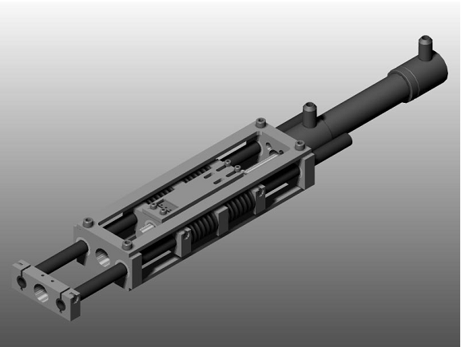
Introduction
Pure Hydroelastic Actuator
Hydraulic Actuator with Variable Impedance
Control Technique
Chronogram
Hydroelastic actuator proposed by Robinson (2000).
Remote manipulator proposed by Buerguer (2005).

Slide 14
Pure Hydroelastic Actuator
Pure Hydroelastic Actuator
2

Slide 15
Introduction
Pure Hydroelastic Actuator
Hydraulic Actuator with Variable Impedance
Control Technique
Chronogram
The main focus in this case is to show the possibility to obtain hydraulically the same behavior obtained by the SEA, extracting the spring and using High Volumetric Expansion (HVE) Hoses or Accumulators.

Slide 16
Introduction
Pure Hydroelastic Actuator
Hydraulic Actuator with Variable Impedance
Control Technique
Chronogram
PHEA
Pure HydroElastic Actuator
This actuation system reduces the hydraulic stiffness using only hydraulic components. Additionally, it saves space in the axial direction and allows a direct contact between the actuator and environment.

Slide 17
Introduction
Pure Hydroelastic Actuator
Hydraulic Actuator with Variable Impedance
Control Technique
Chronogram
The selection of the hydraulic components is based on the principle that the fluid in the cylinder chambers presents a spring effect that can be modulated by adding hydraulic capacitive components, such as high volumetric expansion hoses (HVE hoses) or accumulators.
K
CC
s
Hydraulic Stiffness
K
H

Slide 18
Introduction
Pure Hydroelastic Actuator
Hydraulic Actuator with Variable Impedance
Control Technique
Chronogram
Servovalve
Spool movement equation
Flow-rate dynamics
Hydraulic System
Cylinder
Continuity equation
Rod movement equation
Environment
Movement equation

Slide 19
Introduction
Mathematical modelling
Analysis and Selection of Compliant Components
Application example
Conclusions
SERVOVALVE MODELLING
Spool movement equation:
Flow-rate dynamics:
for U_{C} ≥ 0 (x_{sp} ≥ 0):
for U_{C} < 0 (x_{sp} < 0):

Slide 20
Introduction
Pure Hydroelastic Actuator
Hydraulic Actuator with Variable Impedance
Control Technique
Chronogram
CYLINDER MODELLING
Continuity equation:
Rod movement equation:
Force applied:

Slide 21
Introduction
Pure Hydroelastic Actuator
Hydraulic Actuator with Variable Impedance
Control Technique
Chronogram
For low stiffness reductions, HVE hoses may be selected. Such hoses allow a bigger hydraulic capacitance compared to the common hoses.
The hydraulic stiffness varies nonlinearly with respect to the piston position (x_{p}):

Slide 22
Introduction
Pure Hydroelastic Actuator
Hydraulic Actuator with Variable Impedance
Control Technique
Chronogram
Assuming that the entrance of air into the system is almost nonexistent such that have no influence on the performance of the system, the effective bulk modulus is directly modified by the variation of the container bulk modulus (β_{e} ≈ β_{C} = β_{hose}).
Finally, the required hose length can be calculated:

Slide 23
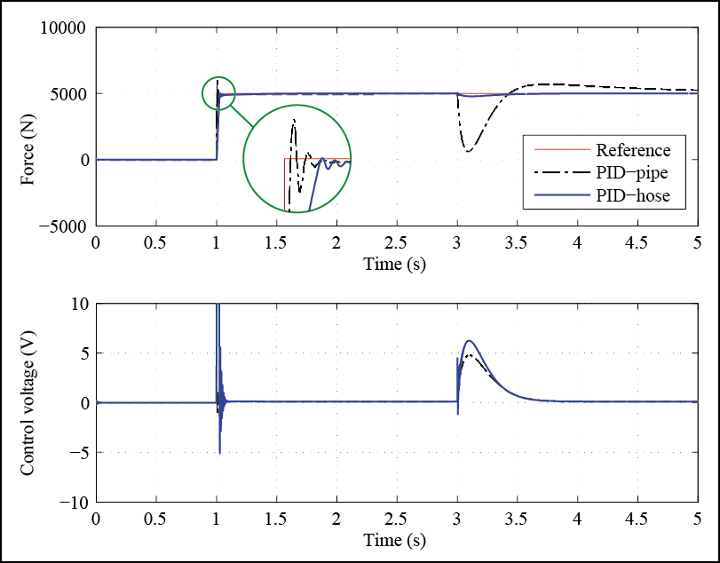
Introduction
Pure Hydroelastic Actuator
Hydraulic Actuator with Variable Impedance
Control Technique
Chronogram

Slide 24

Hydraulic Actuator with Variable Impedance
Hydraulic Actuator with Variable Impedance
3

Slide 25
Introduction
Pure Hydroelastic Actuator
Hydraulic Actuator with Variable Impedance
Control Technique
Chronogram
Hydraulic actuator versatile enough to maintain the system stability despite any variation of the environment stiffness.
Actuator capable of self modify its hydroelasticity in a controlled way fulfilling tasks of force and position control.
Dynamic
HAVI
PHEA
Hydraulic Actuator with Variable Impedance

Slide 26
Introduction
Pure Hydroelastic Actuator
Hydraulic Actuator with Variable Impedance
Control Technique
Chronogram
System with a complex hardware;
Higher economical cost;
It’s necessary to develop a new kind of hydraulic component with variable capacitance;
If necessary, a variable damping component should be added, too.
Compact and hydraulically pure system;
Hydraulic actuator that actually doesn’t exist.

Slide 27
Control technique
Control technique
4

Slide 28
Introduction
Pure Hydroelastic Actuator
Hydraulic Actuator with Variable Impedance
Control Technique
Chronogram
QFT
Was created by the Prof. Isaac Horowitz (1959). It’s a linear technique that adds quantitative characteristic in the frequency analysis initially proposed by Bode (1945).
Quantitative Feedback Theory
Plant model
+
Uncertainties
Performance requirements
Robustness
Performance
Model uncertainties
Disturbances
Bounds
Loopshaping
F
+
G
Quantitative management

Slide 29
Introduction
Pure Hydroelastic Actuator
Hydraulic Actuator with Variable Impedance
Control Technique
Chronogram
Based on a 2-DOF canonical system:
Disturbance before the plant
Disturbance after the plant
Controller
Plant
Output
Reference
Prefilter
Sensor
Noise

Slide 30
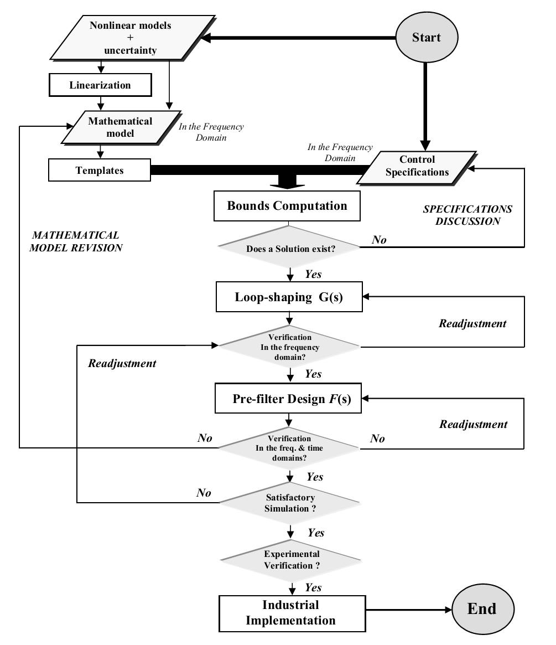
Introduction
Pure Hydroelastic Actuator
Hydraulic Actuator with Variable Impedance
Control Technique
Chronogram
QFT
Procedure

Slide 31
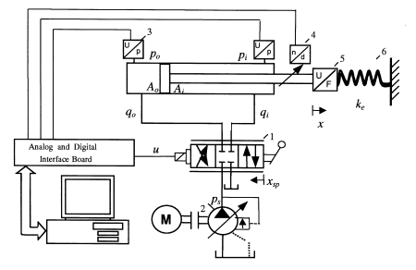
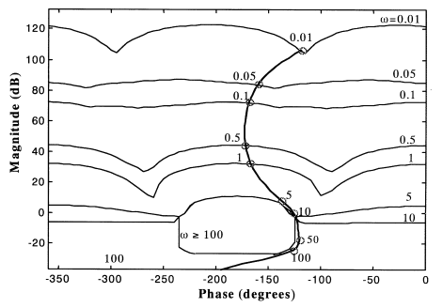
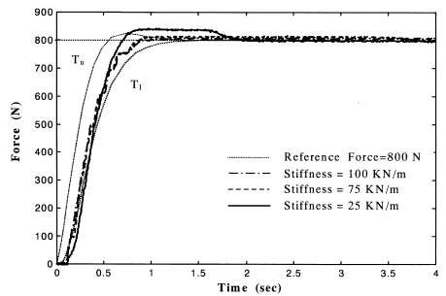
Introduction
Pure Hydroelastic Actuator
Hydraulic Actuator with Variable Impedance
Control Technique
Chronogram
Design and experimental evaluation of a robust force controller for an electro-hydraulic actuator via quantitative feedback theory.
Niksefat & Sepehri (2000)

Slide 32
Chronogram
5
Chronogram

Slide 33
Introduction
Pure Hydroelastic Actuator
Hydraulic Actuator with Variable Impedance
Control Technique
Chronogram
Implement the PHEA in the FC1D;
Experimental validation;
Implement the PHEA in the HyL;
Propose and obtain simulation responses of the HAVI;
Implement the HAVI in the FC1D.
Experimental validation.
Tasks | Months
 | 1° | 2º | 3º | 4º | 5º | 6º | 7º
1
2
3
4
5
6

Slide 34
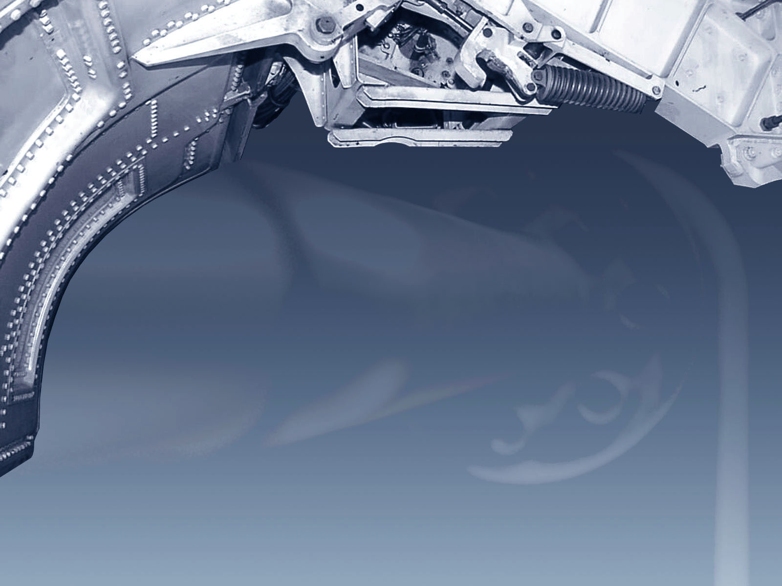
?
?
?
Any questions ??
Thanks !
?

Slide 35




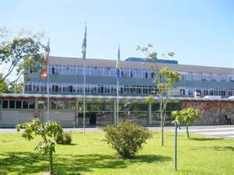

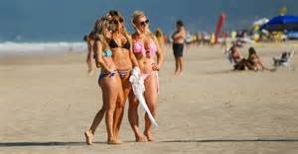
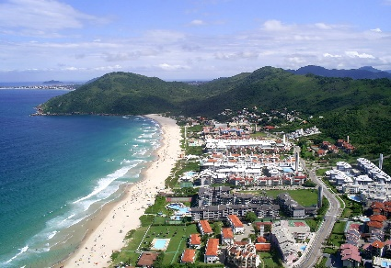
www.laship.ufsc.br/fpni2016

